Slide 1

CHATBOT FOR ANSWERING UPI 123App QUERIES
2010030413 – Nihal Agarwal
2010030374 – Jaideep Sharma
2010030361 – T Venkata Sai Sathvik
2010030153 – Shaik Abdul Shaan

Slide 2
TABLE OF CONTENTS
TOPIC | SLIDE NO
ABSTRACT | 3
PROBLEM STATEMENT | 4
PROJECT AREA | 5
LITERATURE SURVEY | 6
CONCLUSIONS | 7
SUGGESTIONS | 8
THANKYOU | 9

Slide 3
ABSTRACT
A chatbot is a computer program that can converse with humans using artificial intelligence in messaging platforms. The goal of the project is to add a chatbot feature for getting python information.
Chatbots come in two kinds:
A limited set of rules
Machine learning Chatbot that uses a limited set of rules.
This kind of bots is very limited to a set of texts or commands. They can respond only to those texts or commands. If the user asks something different or other than the set of texts or commands which are defined to the bot, it will not respond as desired since it does not understand, or it has not trained what user asked. These bots are not very smart when compared to other kind of bot.

Slide 4
PROBLEM STATEMENT
Artificial intelligence chatbot is a technology that makes interactions between man and machines using natural language possible. From literature, we found out that in general, chatbot are functions like a typical search engine. Although chatbot just produced only one output instead of multiple outputs/results, the basic process flow is the same where each time an input is entered, the new search will be done. Nothing related to previous output. This research is focused on enabling chatbot to become a search engine that can process the next search with the relation to the previous search output. In chatbot context, this functionality will enhance the capability of chatbot’s input processing.

Slide 5
PROJECT AREA
The proposed solution is to create a chatbot to simulate a human conversation to assist users with their banking needs and to provide a more personal experience. Advancements in artificial Intelligence, machine learning techniques, improved aptitude for decision making, larger availability of domains and corpus, have increased the practicality of integrating a chat bot into applications. The chatbot will identify and understand what the user is asking and generate an appropriate response based on the conversational context using NLTK model and skicit learning based model with a GUI (tkinter) with two different file storage method to access the information for end users.

Slide 6
LITERATURE SURVEY
S.No. | Authors | Title | Publishing | Pros | Cons
1 | Garvit Bajpai Rakesh Kumar Kannaujiya | CHATBOT IN PYTHON | Stud (2018) https://www.academia.edu/38409853/CHATBOT_IN_PYTHON | was able to add a basic chatbot functionality in to the Yioop. | The limitations of data processing and retrieval are hindering chatbots to reach their full potential.
2 | Dana Doherty Dr. Daniel Kelly | TASK-BASED INTERACTION CHATBOT | 2017-2018 https://kevincurran.org/dissertations/2018%20Thesis%20Dana%20Doherty%20-%20Chatbots.pdf | The developed chatbot allows users to interact with their bank through natural language interaction, granting users more convenient and efficient access to their banking information.

Slide 7
SURVEY DETAILS
what is UPI ?
What is the full form of UPI ?
I am looking for information on payments using UPI in feature phones
what is the UPI released for feature phones ?
what will UPI 123Pay will do ?
How will the UPI payments work
Does this require a network connection ?
Do the user has to link their bank account with the UPI
what types of transactions can people do ?
In what language's is the UPI operatable ?

Slide 8
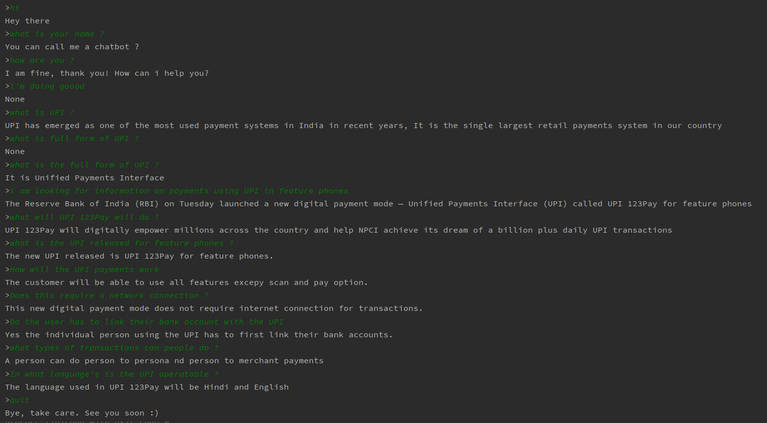
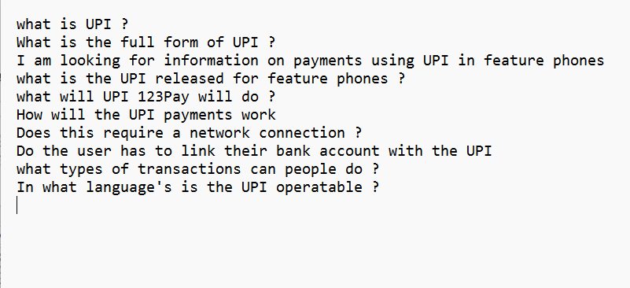
FLOW DIAGRAM
RESULT
NLTK Model
MODEL
import nltk
from nltk.chat.util import Chat, reflections
set_pairs = [
[
r"my name is (.*)",
["Hello %1, How are you doing today ?",]
],
[
r"hi|hey|hello",
["Hello", "Hey there",]
],
[
r"what is your name?",
["You can call me a chatbot ?",]
],
[
r"how are you ?",
["I am fine, thank you! How can i help you?",]
],
[
r"I am fine, thank you",
["great to hear that, how can i help you?",]
],
[
r"i'm (.*) doing good",
["That's great to hear","How can i help you?:)",]
],
[
r"what is UPI ?",
["UPI has emerged as one of the most used payment systems in India in recent years, It is the single largest retail payments system in our country",]
],
[
r"What is the full form of UPI ?",
["It is Unified Payments Interface",]
],
[
r"i am looking for information on payments using UPI in feature phones",
["The Reserve Bank of India (RBI) on Tuesday launched a new digital payment mode — Unified Payments Interface (UPI) called UPI 123Pay for feature phones",]
],
[
r"what is the UPI released for feature phones ?",
["The new UPI released is UPI 123Pay for feature phones."]
],
[
r"what will UPI 123Pay will do ?",
["UPI 123Pay will digitally empower millions across the country and help NPCI achieve its dream of a billion plus daily UPI transactions",]
],
[
r"How will the UPI payments work",
["The customer will be able to use all features excepy scan and pay option.",]
],
[
r"Does this require a network connection ?",
["This new digital payment mode does not require internet connection for transactions.",]
],
[
r"Do the user has to link their bank account with the UPI",
["Yes the individual person using the UPI has to first link their bank accounts.",]
],
[
r"what types of transactions can people do ?",
["A person can do person to persona nd person to merchant payments",]
],
[
r"In what language's is the UPI operatable ?",
["The language used in UPI 123Pay will be Hindi and English",]
],
[
r"quit",
["Bye, take care. See you soon :) ","It was nice talking to you. See you soon :)"]
],
]
def chatbot():
chat = Chat(set_pairs, reflections)
chat.converse()
if __name__ == "__main__":
chatbot()
DATASET
F1 score Evaluation Model
WORKING PROTOTYPE
EVALUATION

Slide 9
SELECTED MODEL AND TECHNIQUES
We are using nltk.chat which is a class for simple chatbots. These perform simple pattern matching on sentences typed by users and respond with automatically generated sentences.
The Chat class Initializes the chatbot. By using pairs as a list of patterns and responses. Each pattern is a regular expression matching the user's statement or question.

Slide 10
PREPROCESSING CODE

Slide 11
import nltk from nltk.chat.util import Chat, reflections set_pairs = [ [ r"my name is (.*)", ["Hello %1, How are you doing today ?",] ], [ r"hi|hey|hello", ["Hello", "Hey there",] ], [ r"what is your name?", ["You can call me a chatbot ?",] ], [ r"how are you ?", ["I am fine, thank you! How can i help you?",] ], [ r"I am fine, thank you", ["great to hear that, how can i help you?",] ], [ r"i'm (.*) doing good", ["That's great to hear","How can i help you?:)",] ],
[ r"what is the UPI released for feature phones ?", ["The new UPI released is UPI 123Pay for feature phones."] ], [ r"what will UPI 123Pay will do ?", ["UPI 123Pay will digitally empower millions across the country and help NPCI achieve its dream of a billion plus daily UPI transactions",] ], [ r"How will the UPI payments work", ["The customer will be able to use all features excepy scan and pay option.",] ], [ r"Does this require a network connection ?", ["This new digital payment mode does not require internet connection for transactions.",] ], [ r"Do the user has to link their bank account with the UPI", ["Yes the individual person using the UPI has to first link their bank accounts.",] ], [ r"what types of transactions can people do ?", ["A person can do person to persona nd person to merchant payments",] ], [ r"In what language's is the UPI operatable ?", ["The language used in UPI 123Pay will be Hindi and English",] ],
[ r"what is UPI ?", ["UPI has emerged as one of the most used payment systems in India in recent years, It is the single largest retail payments system in our country",] ], [ r"What is the full form of UPI ?", ["It is Unified Payments Interface",] ], [ r"i am looking for information on payments using UPI in feature phones", ["The Reserve Bank of India (RBI) on Tuesday launched a new digital payment mode — Unified Payments Interface (UPI) called UPI 123Pay for feature phones",] ],
[ r"quit", ["Bye, take care. See you soon :) ","It was nice talking to you. See you soon :)"] ], ] def chatbot(): chat = Chat(set_pairs, reflections) chat.converse() if __name__ == "__main__": chatbot()

Slide 12
PREPROCESSING RESULT

Slide 14
MODEL EVALUATION
We will be using f1 score model for evaluating the model used for creating the chatbot.

Slide 15
CONCLUSION
It was determined that chatbots perform at a very high standard and provide reliable and rapid responses to users compared to that of traditional methods. The average time spent interacting with the chatbot is very low as it provides an efficient way for users to manage their banking. The low interaction time reflects the high understanding and speech recognition rates, offered through the adoption of conversational user interfaces thus allowing users to freely interact with the chatbot to meet the demands of modern life. The chatbot has proven to fulfil the demand of users wanting instant access and availability information and services.

Slide 16
SUGGESTIONS

Slide 17
THANK YOU

